Slide 1
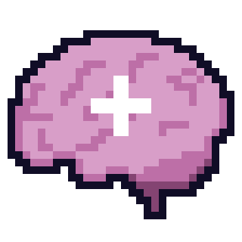

~ DRAINED ~
GROUP 2 GAME JAM
PROJECT PRESENTATION

Slide 2
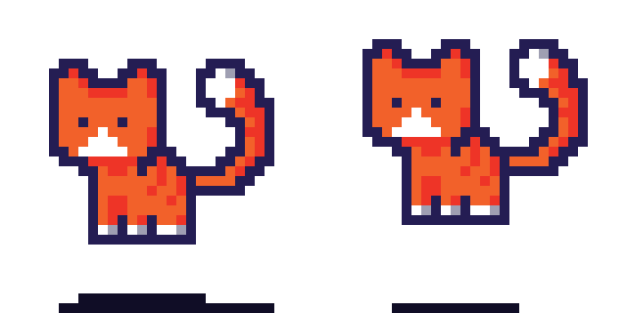
GAME DESIGN
A MULTI-LEVEL CITY-SCAPE BACKGROUND DESIGN INCORPORATING A PLATFORMER-STYLE MECHANIC.

Slide 3
GAME MECHANICS
COLLECTIBLES
RELAXATION SPOTS
TRAPS
Collect 5 stars to win the game.
Touch a number of RS’ to refill the mental health meter.
Deviously placed to obstruct the player.
MENTAL HEALTH METER
SCORE SYSTEM
ADVICE CYCLE
Directly proportionate to the haziness of the screen.
Used to change scenes and keep a score.
Real-life scenarios to help achieve homeostasis.

Slide 4
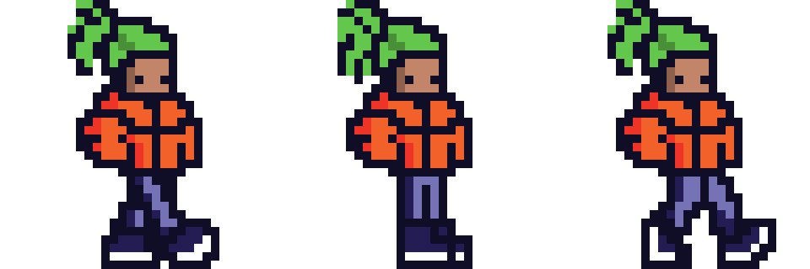
GAME FEEL
The player can choose between two modes—normal and endless:
Normal—the player must visit seven relaxation spots to advance to the next level. The player must also collect 5 stars to finish the game.
Endless Mode—The player will compete with the enemy AI to obtain a score (Outlining the effect of using GA’s).

Slide 5
AI TECHNIQUES
FINITE STATE MACHINES
GENETIC
ALGORITHMS
PROCEDURAL MAP GENERATION
A*
(ENEMY AI)

Slide 6

PROGRAMMING & AUDIO
Consisted of a number of third-party components.
Sfxr—custom sound effects
Bandlab—custom background tunes
Youtube—one-off music asset
A* Package Imported Directly to be used within Unity.

Slide 7
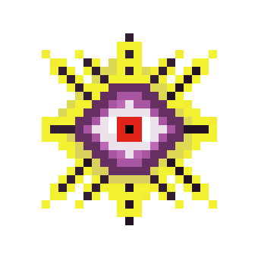
GAME THEME – MENTAL HEALTH
Revolving around mental fatigue.
The ‘Monster’ portrays a judgmental eye (society, social media).
The user must avoid the eye while keeping a close eye on their mental health and finding the balance between avoiding the eye and reaching the relaxation points to replenish their mental health and progress to the next level.
Screen starts to blur-signaling exhaustion.

Slide 8
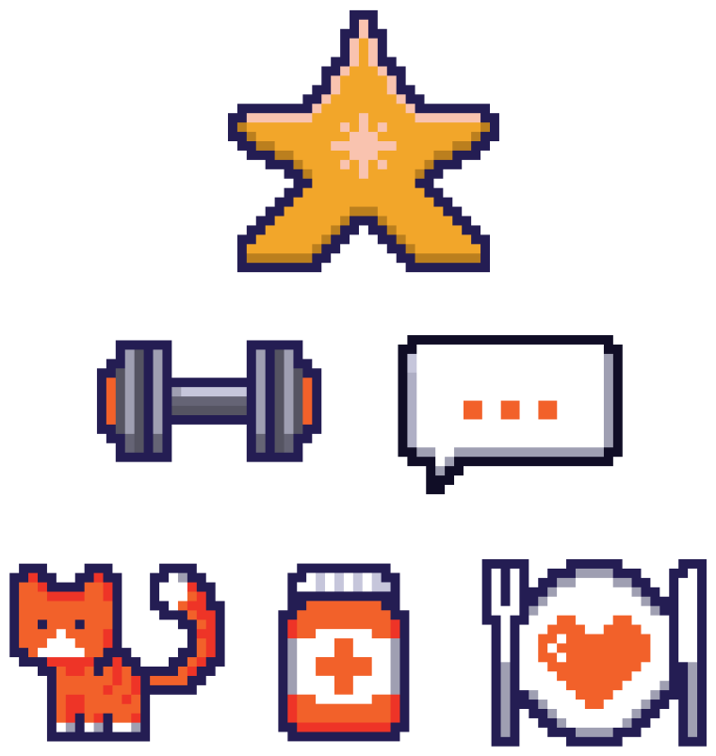
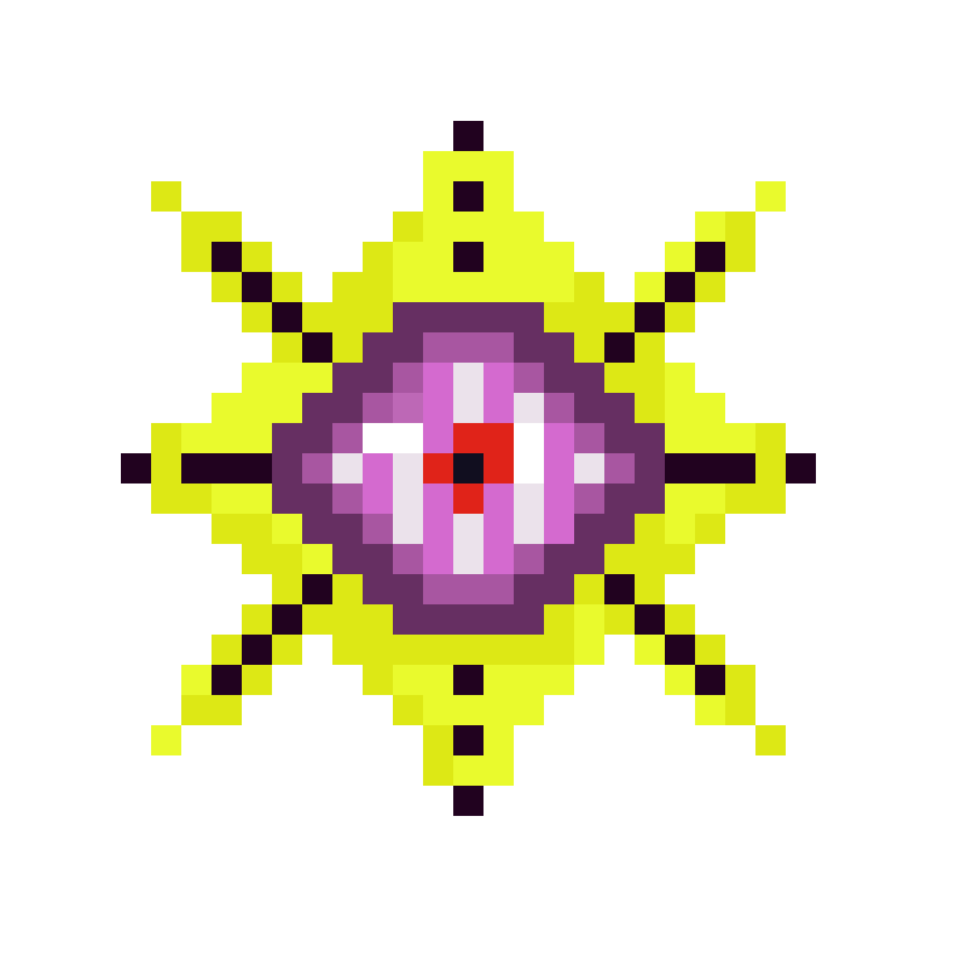


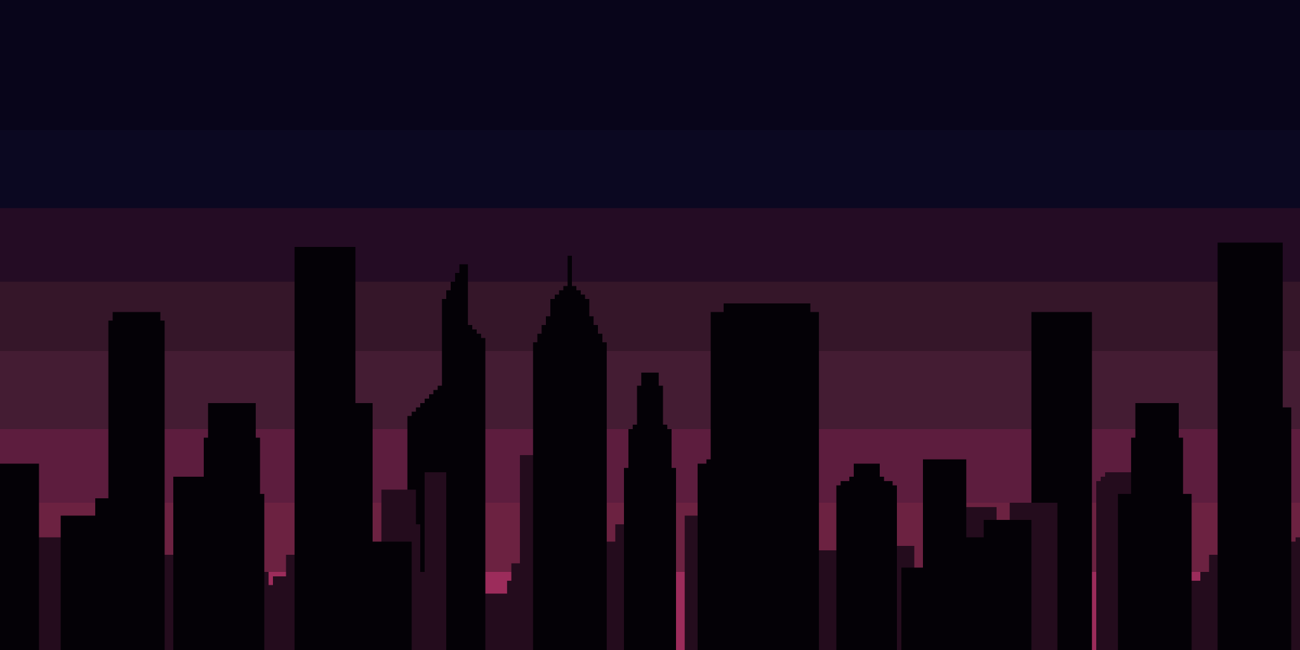

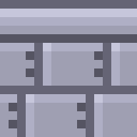
DESIGN
Background
Clouds
Tiles
Character sprites
Eye Monster
Collectables
Relaxation Spots/Icons
Task Icon
Mental Health Bar
Hazards/Obstacles
Pop Up Board

Slide 9
~ THANK YOU ~
ARTWORK AND DESIGN
Dorianne Attard
Xeni Kitzoglou
GAME DEVELOPMENT
Andrea Avona
Anthony Mifsud
Gabriel Borg
Jan Lawrence Formosa
Jonathan Polidano
Matthias Bartolo

